Slide 1


SAP Business One Introduction
Digitalization for Your Business
Global Roll-out, SAP
July, 2019

Slide 2
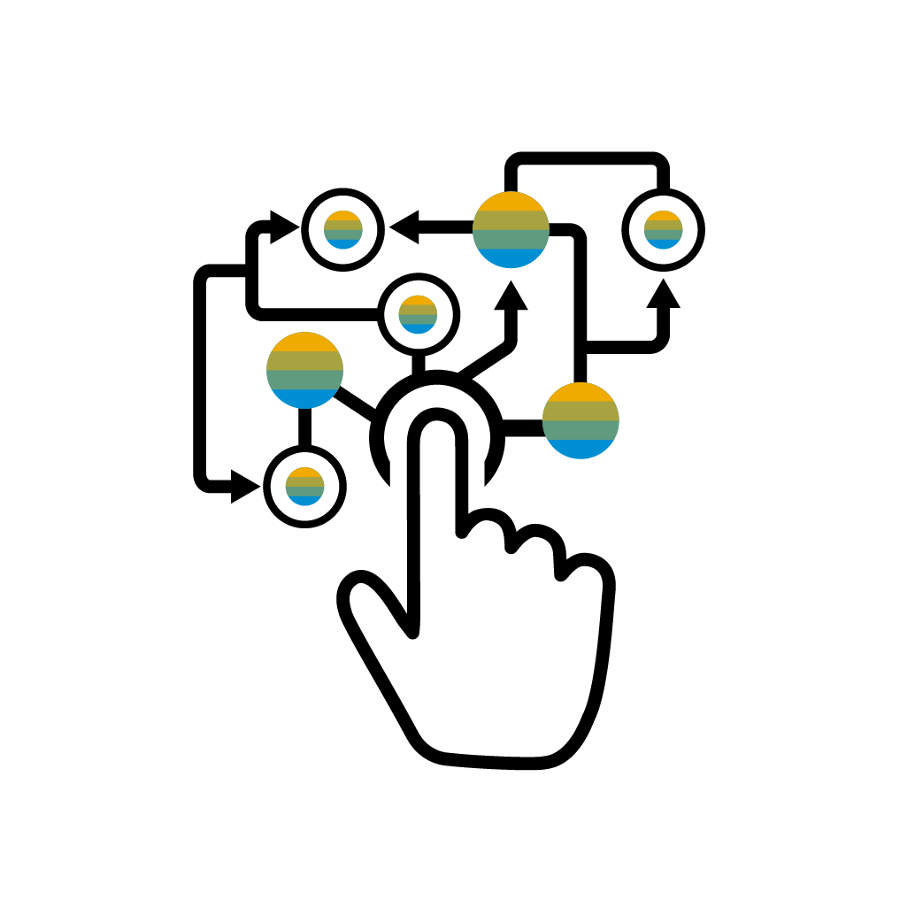

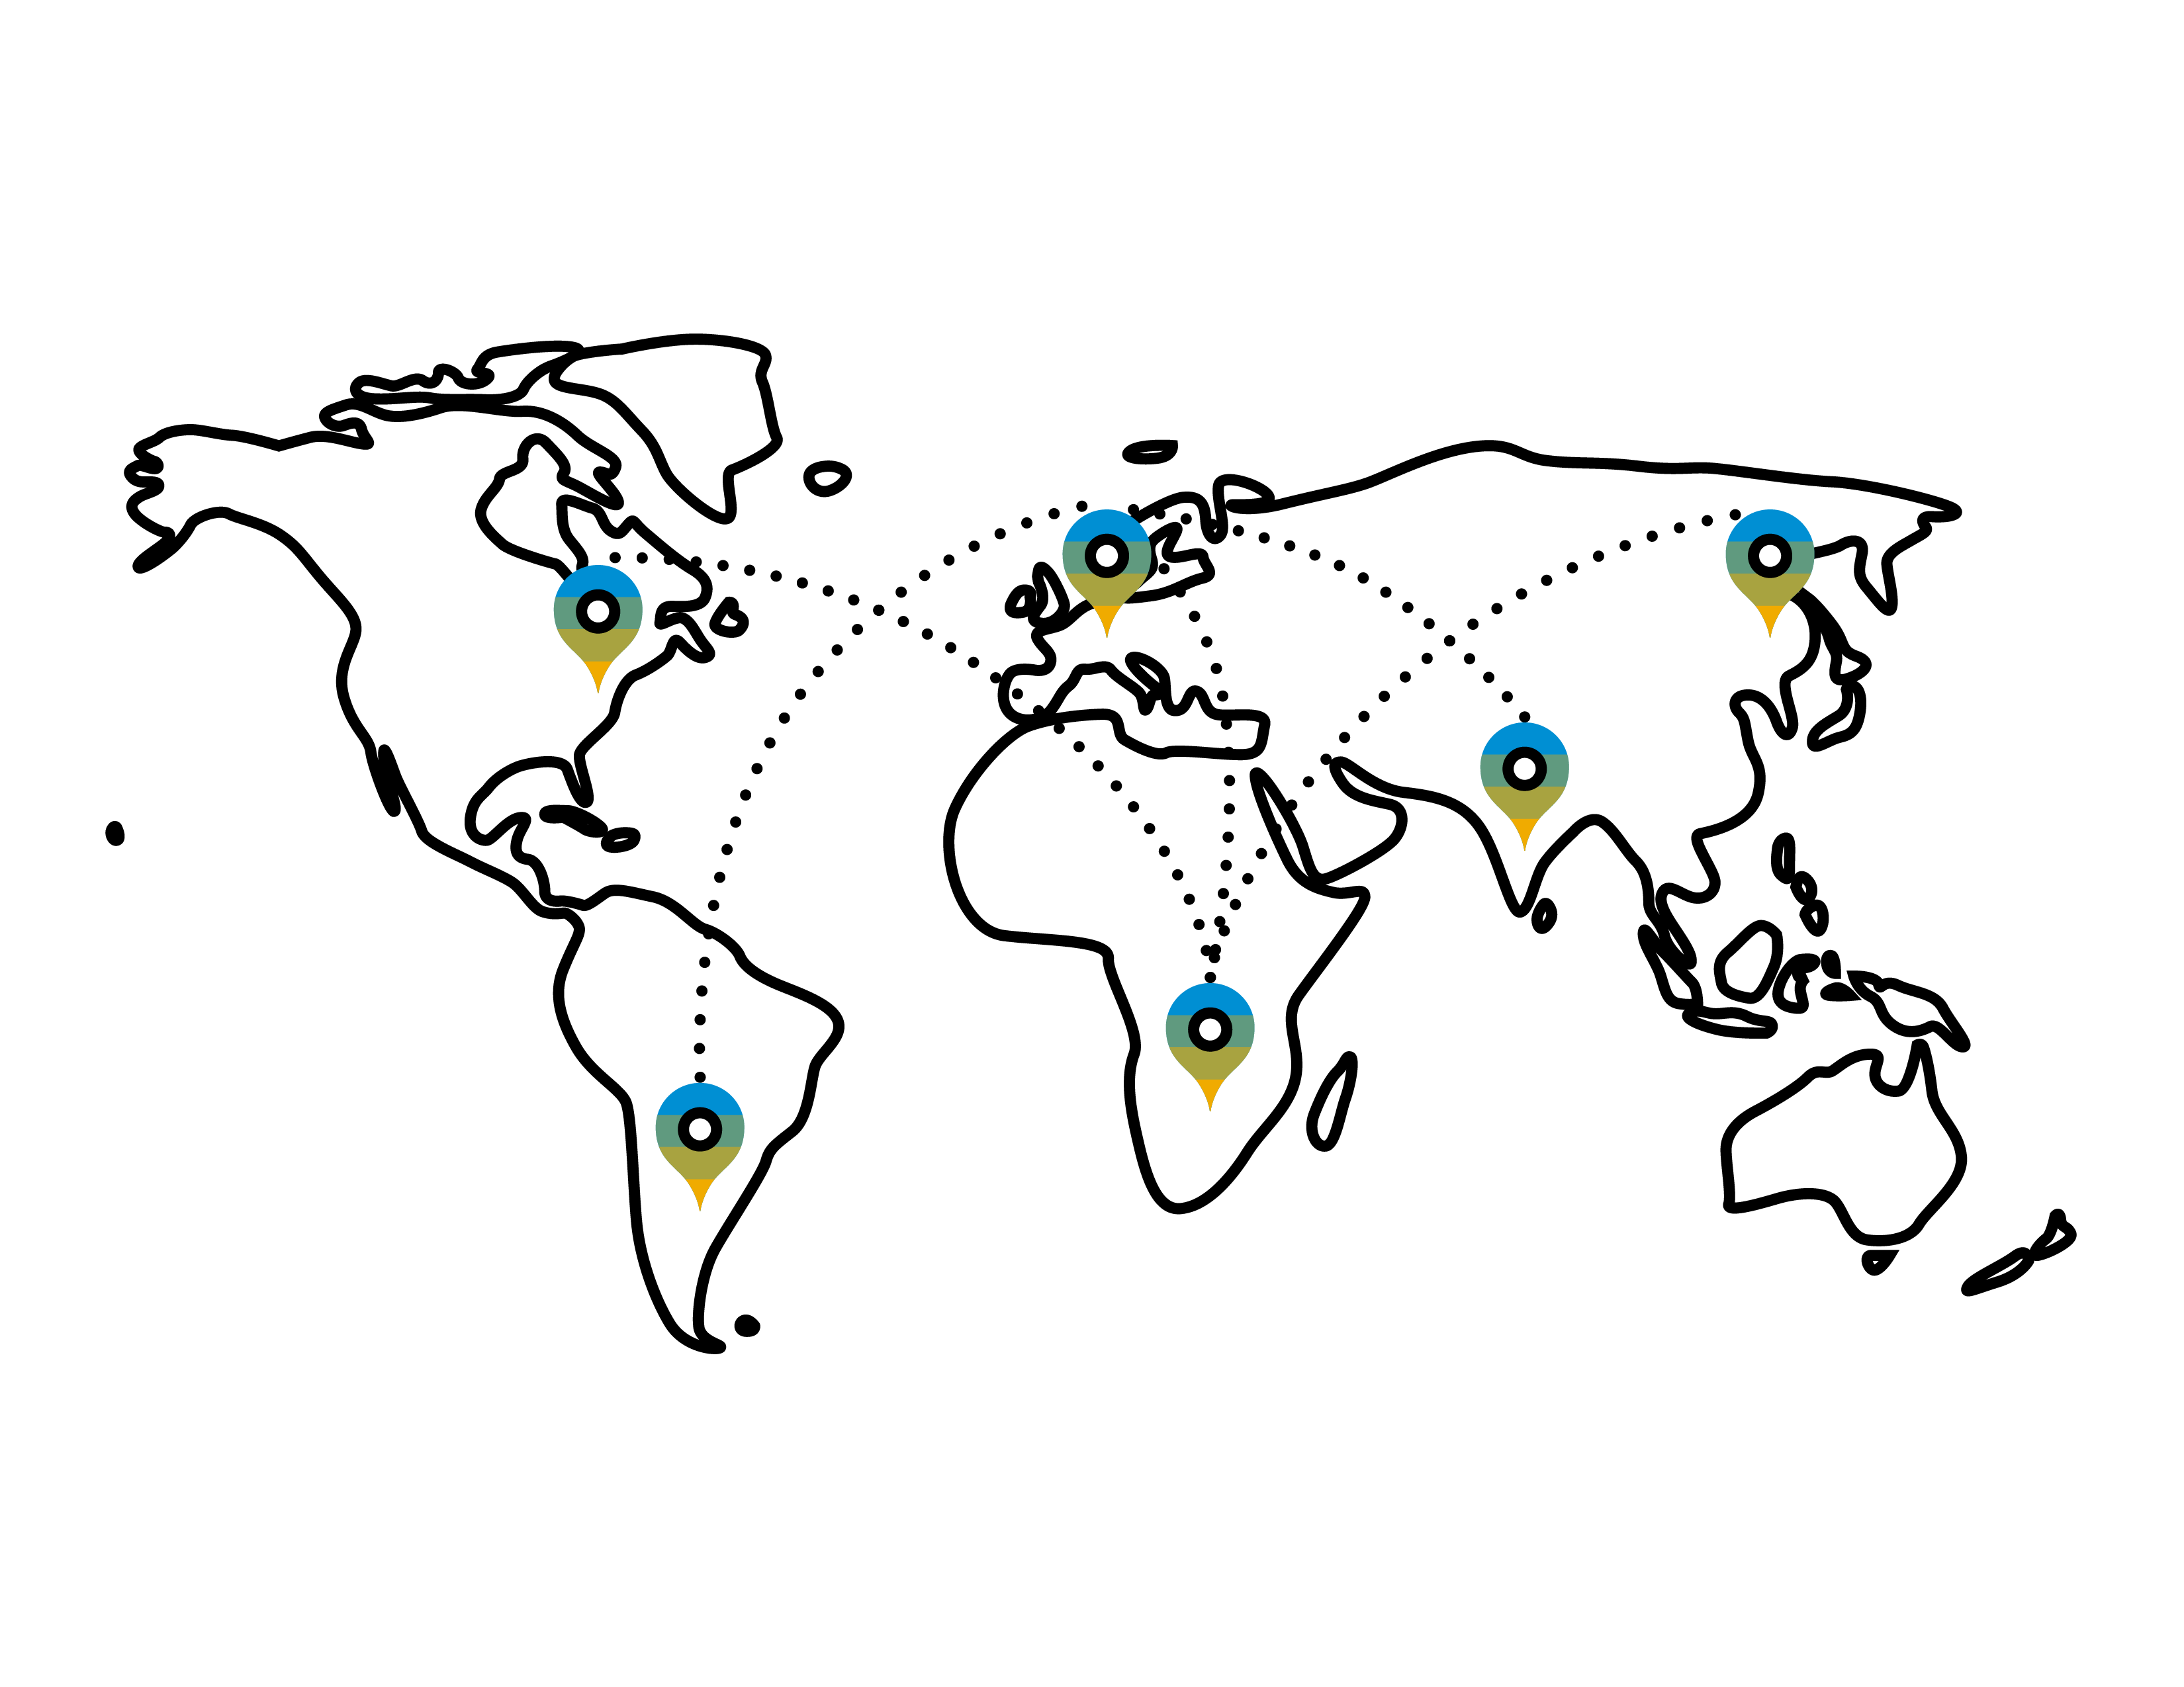
Why explore ERP system?
As your business changes, a solid underlying foundation is critical
It‘s time to go digital
You want to make the right business decisions at the right time, with real-time access to information
You need to automate your business processes, to increase productivity
You are growing
You are a fast growing company, and your needs are out-pacing your current system capabilities
As your business grows, you need to put best-practice processes in place
You are expanding
If you are expanding into new markets, you need business software that will enable you, not hinder you
Enable your subsidiary network to harmonize business and intercompany processes

Slide 3

Run your Business with a Digitized ERP Solution
Keep your focus on running your business!
Competitive Advantage
  Become relevant in the global economy by implementing robust business process, allowing you to adapt to market changes, and anticipate business trends
Connect Business Functions
  Your entire business runs more smoothly by touching all business areas which assists by natural cross departmental collaboration within your organization
Easy Access to Data
  Analytics and reports helps you to keep informed about your business to make decisions on the back of real-time data insights

Slide 4

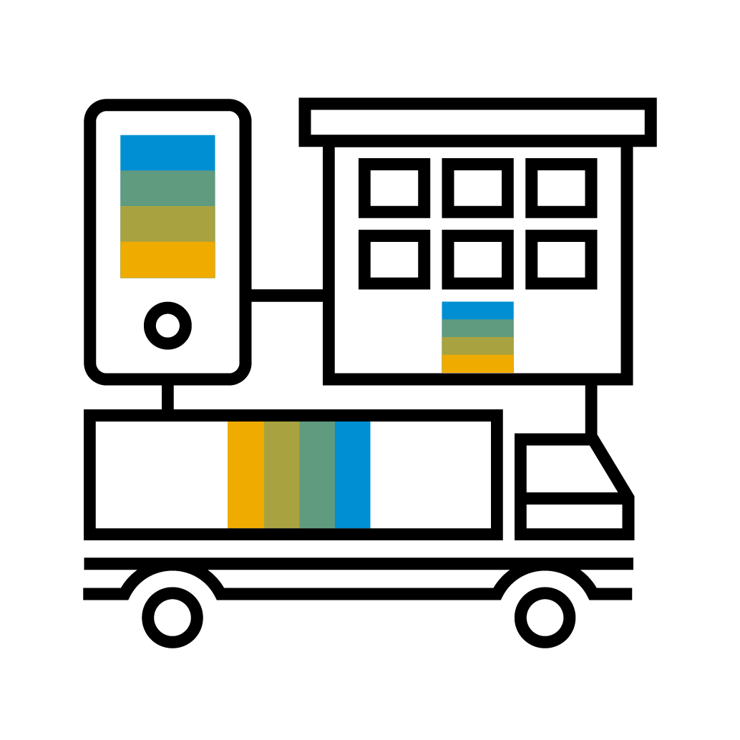






Meet the Digital Core for SMEs
SAP Business One
Management
& Administration
Purchasing
& Operations
Accounting
& Financials
Sales &
Service
Inventory &
Distribution
Project & Resource
management
Production
& MRP

Slide 5

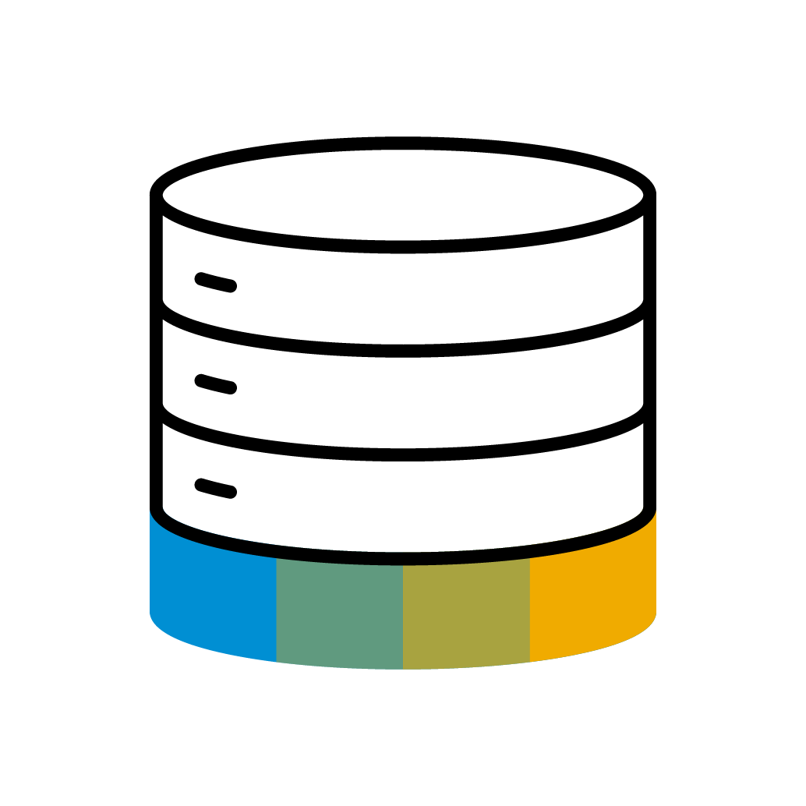


Digital Business – Enablers
Digital business is built on new computing infrastructure – the enablers are…
Analytics
Big Data
Cloud Technologies
Mobile Technologies
…accelerated by the Internet of Things (IoT), advances in Machine Learning and innovations like Blockchain.
These technologies give your company the ability to change your business models, and create new products and services in the digital economy.

Slide 6
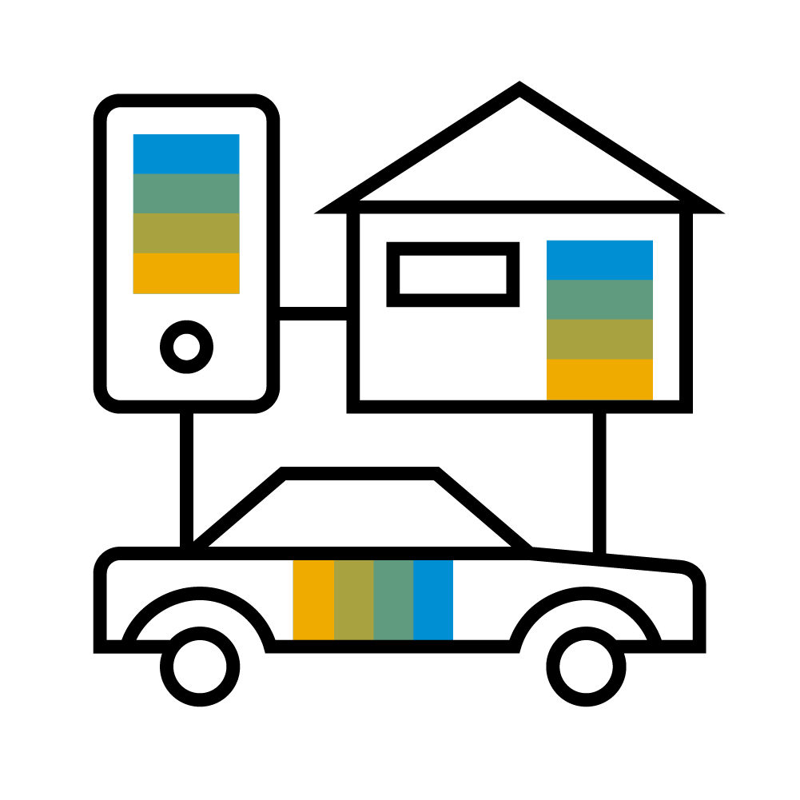

The Digital Core For SMEs
Enhanced by the Digital Enablers
Management
& Admini-
stration
Analytics
Purchasing
& Operations
Accounting
& Financials
Cloud
Technologies
Sales &
Service
Inventory & Distribution
THE DIGITAL CORE FOR SMEs
Mobile
Technologies
Internet of Things
(IoT)
Project & Resource
Management
Production
& MRP
Big Data
Machine Learning

Slide 7
Need more information?
A presentation for “The Digital Business with SAP Business One” is available on the SAPPartnerEdge.com.
Link: The Digital Business with SAP Business One
When and How to Use: This pitch is meant for prospect/customer presentations to show more details about the available capabilities in the digital business with SAP Business One and the digital transformation.
Please use the newest version for your presentations.

Slide 8
Additional Elements for SAP Business One

Slide 9
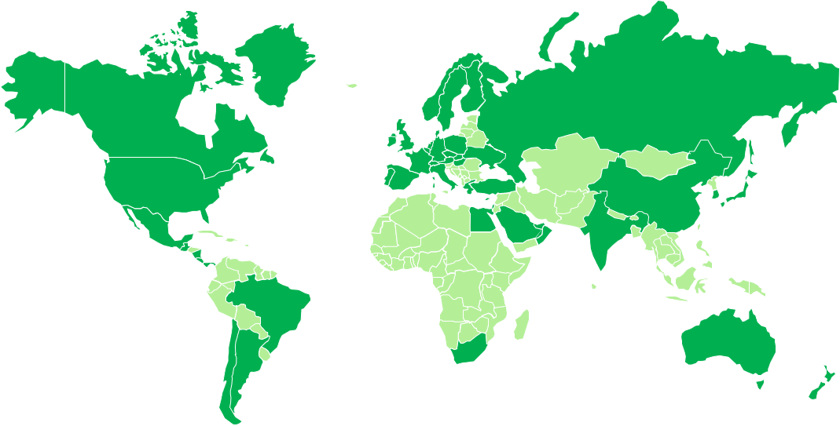
SAP Business One used in more than 170 countries
Master the challenge of globalization in your business
 | Current localizations (50)
Argentina |  | Finland | Mexico | Slovakia
Australia |  | France | Netherlands | South Africa
Austria |  | Germany | New Zealand | South Korea
Belgium |  | Greece | Norway | Spain
Brazil |  | Guatemala | Oman | Sweden
Canada |  | Hong Kong | Panama | Switzerland
Chile |  | Hungary | Poland | Turkey
China |  | India | Portugal | Ukraine
Costa Rica |  | Ireland | Puerto Rico | United Arab Emirates
Cyprus |  | Israel | Qatar
Czech Republic |  | Italy | Russia | United Kingdom
Denmark |  | Japan | Saudi Arabia | United States
Egypt |  | Lebanon | Singapore
 | Countries making use of localizations
Customers in more than 170 countries use localization of other countries, own customization, or partner solution
Current system languages (28)*:
Arabic, Chinese (simplified/traditional), Czech, Danish, Dutch, English (UK/U.S.), Finnish, French, German, Greek, Hebrew, Hungarian, Italian, Japanese, Korean, Norwegian, Polish, Portuguese (Brazil), Portuguese, Russian, Slovak, Spanish (Latin America), Spanish, Swedish, Turkish, and Ukrainian
*Convenient option to make additional languages available is using a partner solution (for some countries bundled with functional add-ons) or to define customer specific UI terms using the Custom Language Tool as detailed in SAP Note 1757764.

Slide 10




Integration Products at a Glance
Connecting your business networks
 | Standard Integration Scenarios (capability delivered with SAP Business One)
Dashboards, SAP mobile apps, outsourced payroll, automated request for quotation, integration of web-based SAP Customer Checkout application, Ariba Network integration (purchase order and invoice automation), SAP Hybris Cloud for Customer (best practice for sales side)
 | Subsidiary Integration (dedicated integration solutions out-of-the-box)
Integrates SAP Business One running in subsidiaries* with SAP Business Suite software in headquarters’ location Data harmonization, financial consolidation, business process standardization, and supply chain optimization Pre-configured scenarios for master data, sales, purchasing, HQ reporting, and finance as well as customer-specific content
 | Possible Integration Scenarios (Integration framework as development environment)
Non-SAP, cloud-based extensions, electronic data interchange, social networks, collaboration (business to business, business to consumer), web shop, web services
 | Intercompany Integration Solution (dedicated application out-of-the-box)
Integrates different SAP Business One databases in a seamless and easy to consume way: Streamline and automate intercompany transactions and processes, such as master data distribution and financial consolidation
* Including branches or franchises of large enterprises

Slide 11


Industry-specific Solutions
Extend to meet your specific business and industry challenges
Software solution partners have the industry expertise and customer focus to offer industry-specific and horizontal solutions
Industry Solutions
Automotive Consumer Products Engineering Food & Beverage Healthcare High-tech Industrial Machinery/Components Retail Wholesale Distribution
Horizontal Extensions
Go beyond generic business needs by extending: Accounting Enhanced CRM Payment Processing Productivity Mobility Reporting Service

Slide 12


SAP Business One Deployment Options
On premise and Cloud
On premise
Cloud
Key Benefits
Compliance with internal Data Security Policies Direct control and access to your data, allowing flexibility in local reporting accesses Better ability to customize and extend your business process Leverage internal hardware and existing IT infrastructure and resources Perpetual licensing, with higher upfront cost but better long-term TCO Less dependence on always-connected internet
Key Benefits
Easy and affordable deployment Secure browser-based access from anywhere, at any time Access to the most up-to-date functionality without having to use rely on in-house IT resources to maintain the solution Subscription licensing avoiding capital expenditure and allowing for operational expenditure flexibility Manage your most critical business functions in your Web browser.

Slide 13

Make Real-Time Business Decisions with Apps…
Support your business decisions with accurate information
SAP HANA Apps
Enterprise Search
Find any information within your organization, just like searching on an internet search engine!
Cash Flow Forecast
Make informed decisions instantly, ensuring healthy liquidity ratios
Available-to-Promise
Interact with current and future stock levels to ensure you can satisfy your customer demands
Delivery Schedule Management
Prioritize customers orders via a drag-and-drop interface, ensuring on-time delivery
Intelligent Forecast
Implement lean inventory management techniques thus improving efficiency and increase profits
Sales Recommendation
Suggest other items on-the-fly based on historical buying patterns of the customer and items

Slide 14

…and Analytics
Support your business decisions with accurate information
Analytics and Reporting
Interactive Analysis
Create flexible ad-hoc analysis within the familiar Microsoft Excel
Pervasive Analytics Designer
Customize and create new analytics, amplifying the end user experience
Dashboards and Advanced Dashboards
Embed across all business forms and functions empowering end users with up-to-the-second information
Key Performance Indicators (KPIs)
Track business-critical measures
Cockpit
Visualize all analytics in your user specific SAP Business One Desktop
Excel Report Designer
Create predefined Microsoft Excel reports with a real-time connection to your business data
Analytical Portal
Run and schedule Crystal Reports and Excel Reports in real time through a web browser
Semantic Layer
Aiding end users to access information freely using common business terms
SAP Crystal Reports
Generate and create feature rich and interactive reports with the embedded

Slide 15

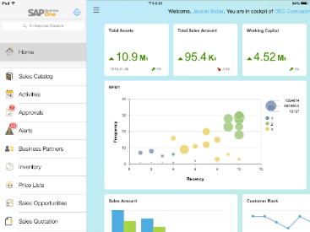
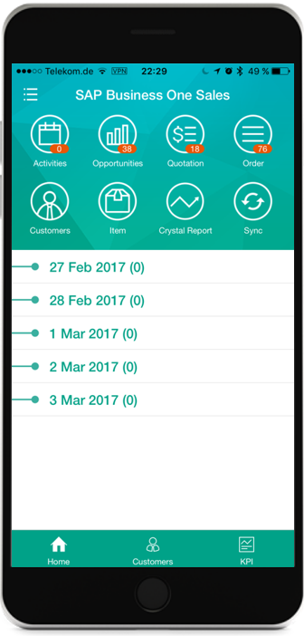
Run your Business with native Apps
Access important business data from any location at any time
Mobile Apps
Key Benefits
Instant access for employees who need to view and update data from anywhere Integrated analytics enable decisions to be made in real time Comprehensive sales and service functions Increase productivity of employees on the road

Slide 16

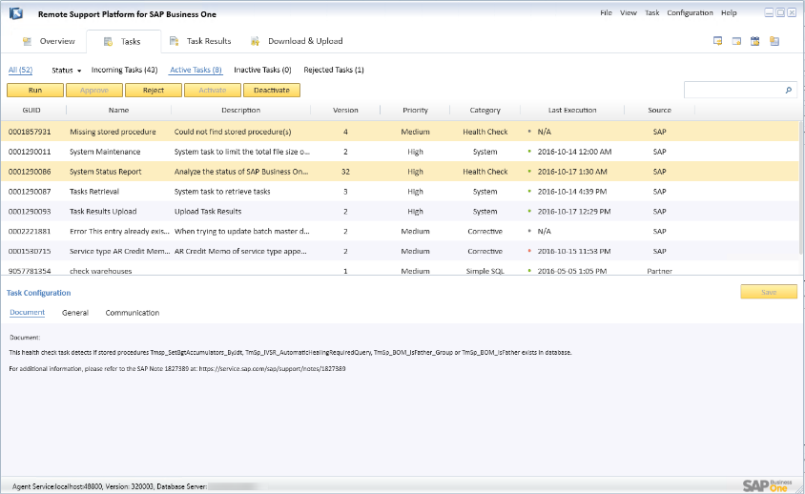
Simplified and Automated Lifecycle Management
With Remote Support Platform 3.2 for SAP Business One
Key Benefits
Reduce your TCO due to increased operational effectiveness and decreased time for support Reduce time for system maintenance, i.e. simplified upgrades, automated back-ups, and repairs Get accelerated and predictable problem resolution Achieve peak system performance, stability and improved data consistency Minimize unplanned downtime and business disruption

Slide 17
Start Changing Your Business – Now

Slide 18

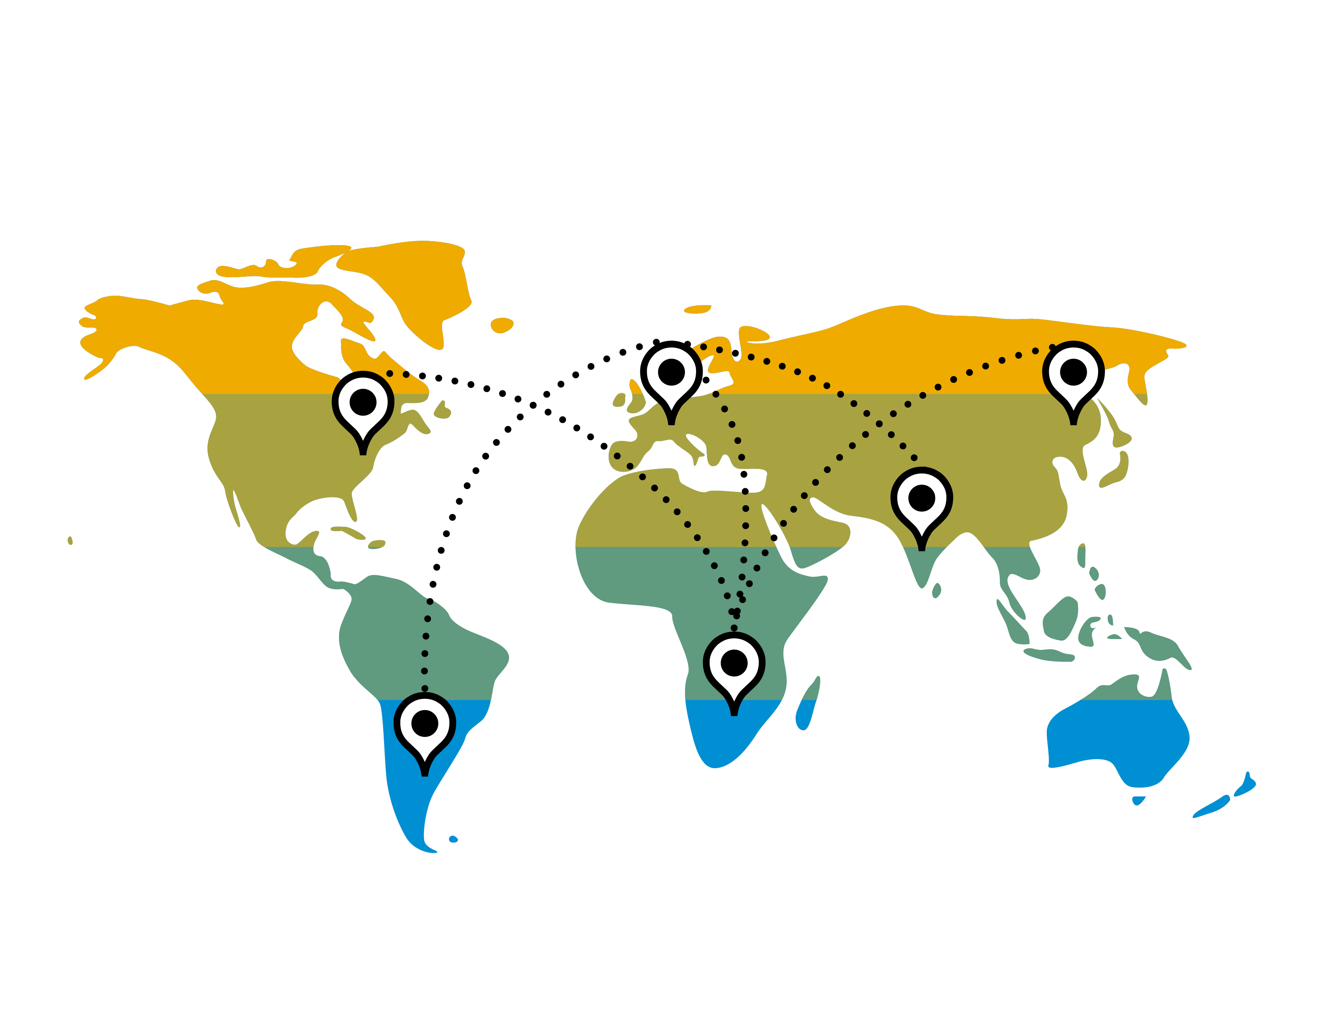

Why Become a Digital Business?
As your business changes, a solid underlying foundation is critical.
Digital Economy
  You want to make the right business decisions at the right time,
  with real-time access to information
You are Growing
  You are a fast growing company, and your needs are out-pacing
  your current system capabilities
  As you business grows, you need to put best-practice processes in place
  You need to automate your business processes, to increase productivity
Expansion
  If you are expanding into new markets, you need business software
  that will enable you

Slide 19
A good ERP Solution… allows you to focus on running your business
Competitive Advantage
Connected Business Functions
Easy Access to Data
Become relevant in the global economy by implementing robust business processes
Allow your business to adapt to market changes, and anticipate business trends
Procurement and production systems are connected to finance. Business data is connected to sales and service
Your entire business runs more smoothly by touching all areas of collaboration within your organization
Integrated analytics and reports should always keep informed on the health of your business
Better decisions can be made on the back of real-time data insight

Slide 20


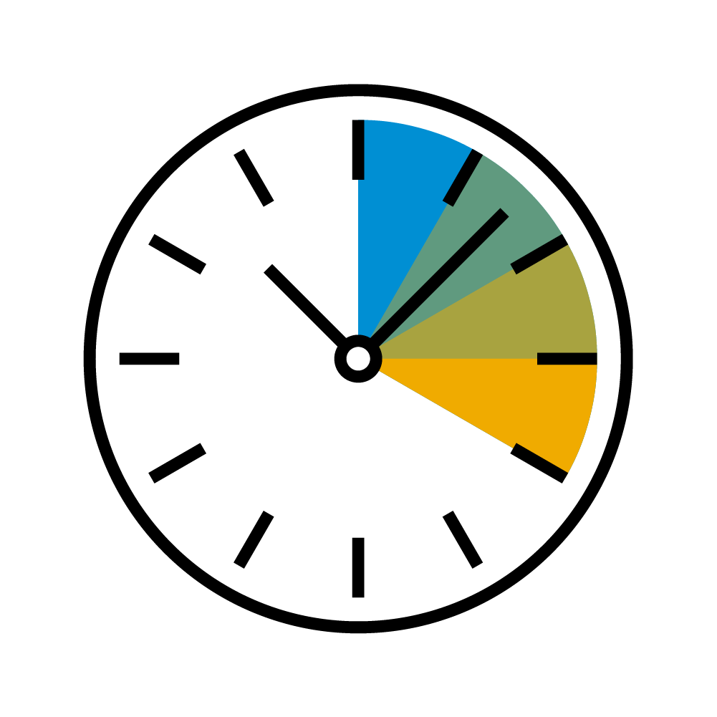
Easy to Set Up, Use and Optimize
Get started quickly and see results
Complete and Integrated
All essential business functions –
from accounting and sales to purchasing and inventory
Available “out of the box”
Gain complete visibility and control
Fast Time to Value
Intuitive and easy for your
employees to adopt and use
Implement in a short time period
Embedded implementation tools based on the proven Accelerated Implementation Program
Simple and Affordable
Quick to set up and optimize
Easy to use
Get the latest technology priced for small and growing businesses

Slide 21





SAP Business One
SAP’s best selling ERP solution by number of customers
Used by 65,000+ customers
Available as 50 country localizations and in 28 languages
~300 Software Solution Partners with 500+ solutions
Implemented by more than 700 Value Added Resellers worldwide
SAP Business One is used in 170 countries
360+ large enterprises are running SAP Business One in 5,600+ subsidiaries

Slide 22
Appendix

Slide 23
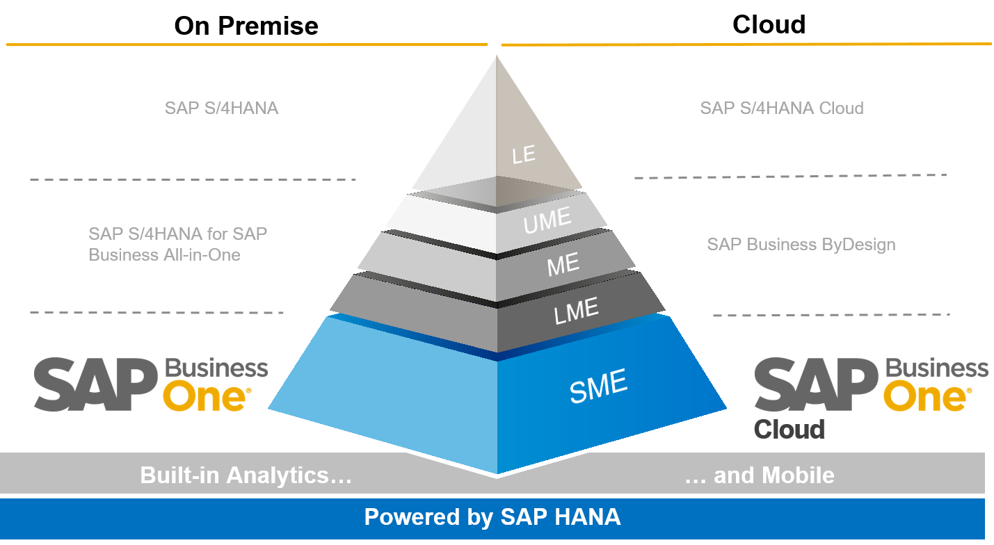
SAP Business One Positioning for Small and Midsize Enterprises
The SME ERP solution that uses in-memory technology and offers “freedom of choice” deployment

Slide 24

SAP Business One Key Functionality
SAP Business One Client
Mobile
Analytics/Dashboards
Multilingualism/Localizations
Management
& Administration
Accounting
& Financials
Purchasing
& Operations
Sales &
Service
Inventory
& Distribution
Production
& MRP
Project & Resource
Management
Solution Customizing
User administration
Authorizations
Multiple currencies
Exchange rates
Multiple posting periods
Multi-branch
Data import
Opening balances
Approval processes
Calendar
Microsoft Office integration
Mobile Interaction
Recurring transactions
Drop Ship
Chart of accounts
Journal entries
Posting templates
Recurring postings
Financial reports
Budget management
Cost accounting
Incoming payments
Outgoing payments
Payment run
Bank statement processing
Checks & credit cards
Deferred payments
Account reconciliation
DATEV / ELSTER (DE)
Fixed Assets
SEPA
Purchase request
Purchase quotations
Web-enabled RFQ
Purchase orders
Goods receipt POs
Goods returns
A/P Invoice
A/P Reserve Invoice
Down-payment Invoice
Down-payment request
Cancel Marketing Documents
A/P credit memos
Landed costs
Intrastat
Opportunity and
pipeline Mgmt.
CRM
Campaign Mgmt.
Blanket agreements
Quotations
Sales orders
Deliveries & Returns
Invoices
Dunning & Customer Mgmt.
Gross profit calculation
Service Mgmt.
Service planning
Customer interactions tracking
Equipment card handling
Service Dashboards
Service contracts
Human resource integration
Knowledge database
Service calendar
Service call processing
Item management
Item lists
Price lists
Goods receipts
Goods issues
Inventory transactions
Transfers
Serial number mgmt
Batch number mgmt.
Price lists in multiple currencies
Special prices
Period and volume discounts
Pick and pack
Recurring transactions
Inventory Tracking
Bin Location
Multiple Measurements
Inventory Counting
Bills of material
Item Sets
Production orders
Goods issues
Goods receipts
Production Dashboards
GL Account Determination
Life Cycle Mgmt.
Item cost calculation
Forecasts
MRP
Make to order
Order recommendations
Production Routing
Project management
Project stages
Stage dependencies
Sub-projects handling
Project Time Reporting
Internal project handling
Employee master data
Time sheet entries
Resource master data
Resource capacity planning
Gantt chart capacity viewing
User-defined fields creation
User-defined tables creation
User-define queries creation
SQL Query Generator
Form UI configurator
User-defined alerts
Transaction notifications
Workflow designer
Business process checklist
User defined Cockpit
User-defined workbench

Slide 25
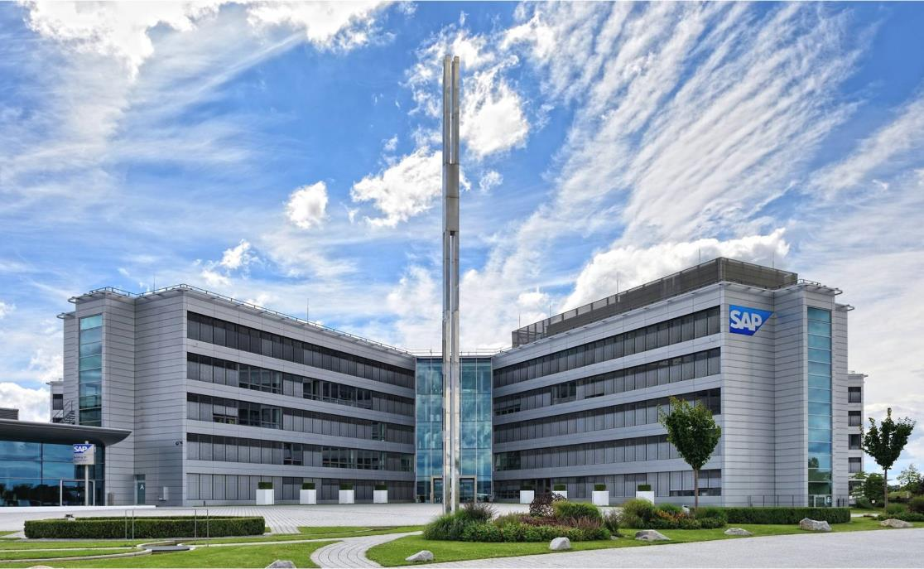
About SAP SE
Employees and Basic Facts
Headquarters: Walldorf, Germany
Founded: April 1, 1972
Listing: Frankfurt, New York
98,659 employees worldwide (3/31/2019)
  >144 nationalities worldwide
Customers
SAP serves >437,000 customers in >180 countries
77% of the world’s transaction revenue touches an SAP system
Market Position
SAP is market leader in:
  Enterprise application software
  Analytics and Business Intelligence
  Experience management software
Recognized database leader
Broadest portfolio of modular and suite solutions available on premise, in the cloud and hybrid:
customers have full choice of consumption model
Source: Corporate Fact Sheet

Slide 26
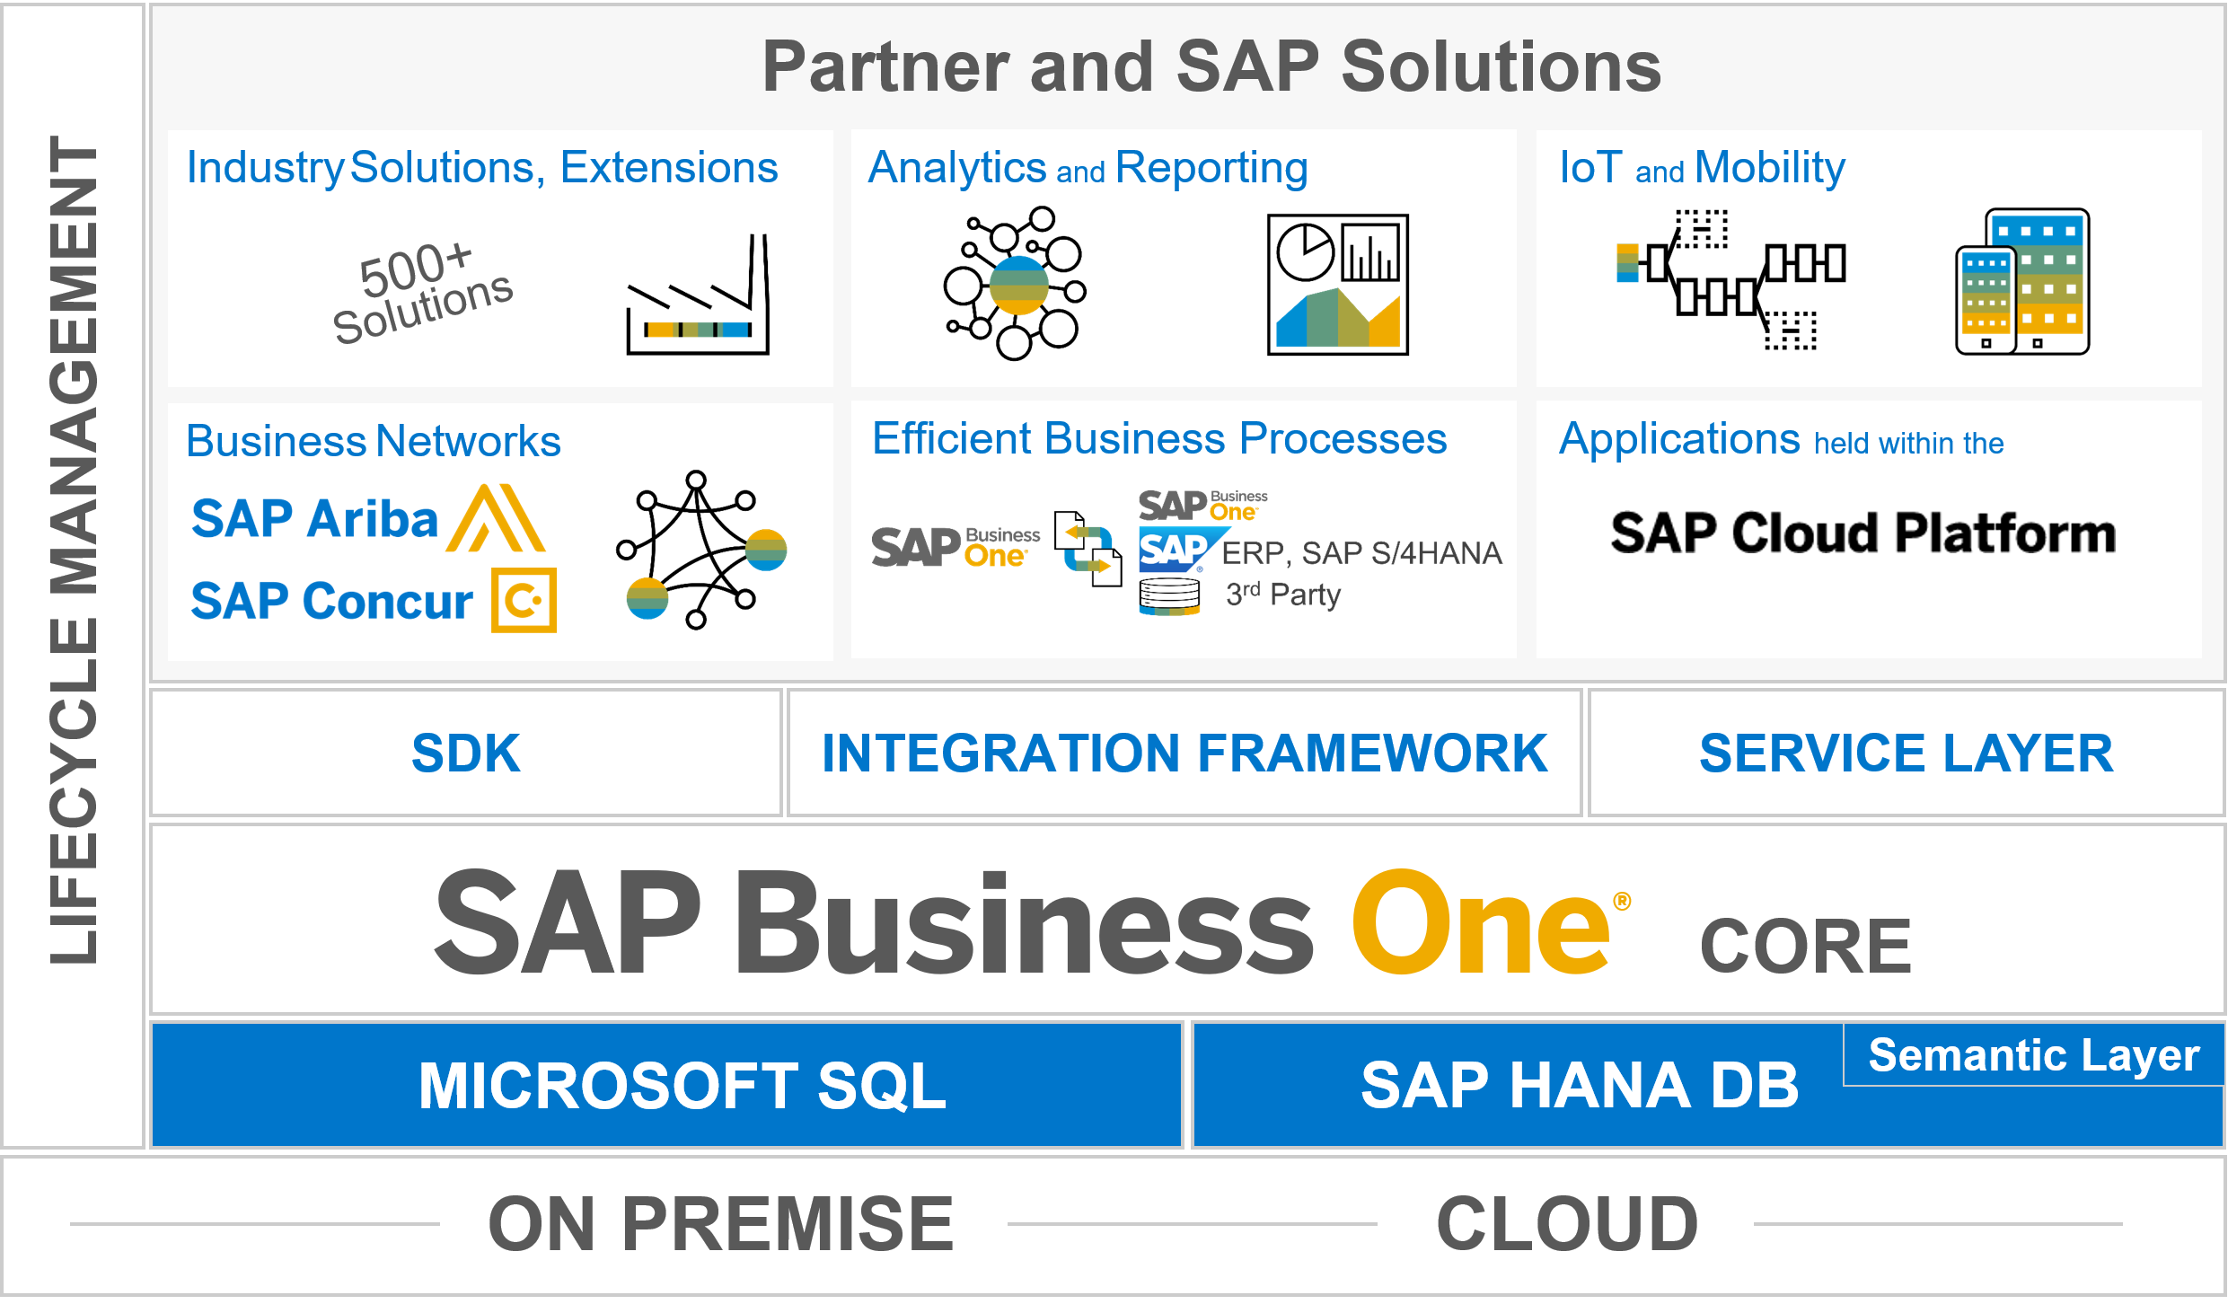
SAP Business One solution stack
Customer needs and the value propositions of the product
Low cost of ownership
and support
Expands the solution scope
Robust integration and collaboration
Extensibility
Interface for
SAP HANA apps
Coverage of all standard
business processes
Running on in-memory
technology
Deployment flexibility

Slide 27
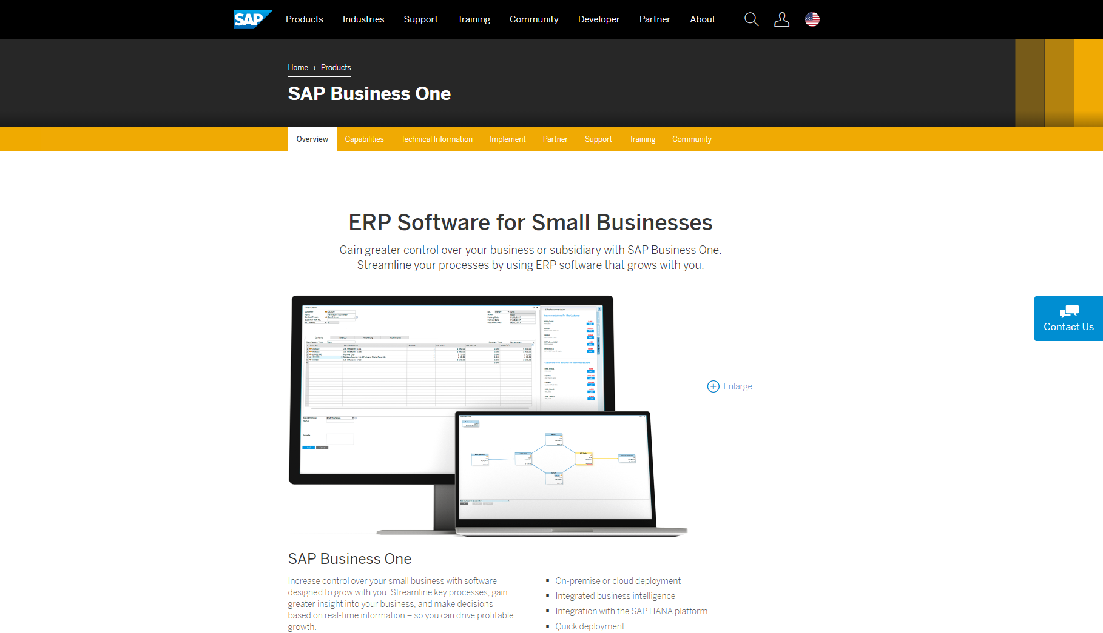
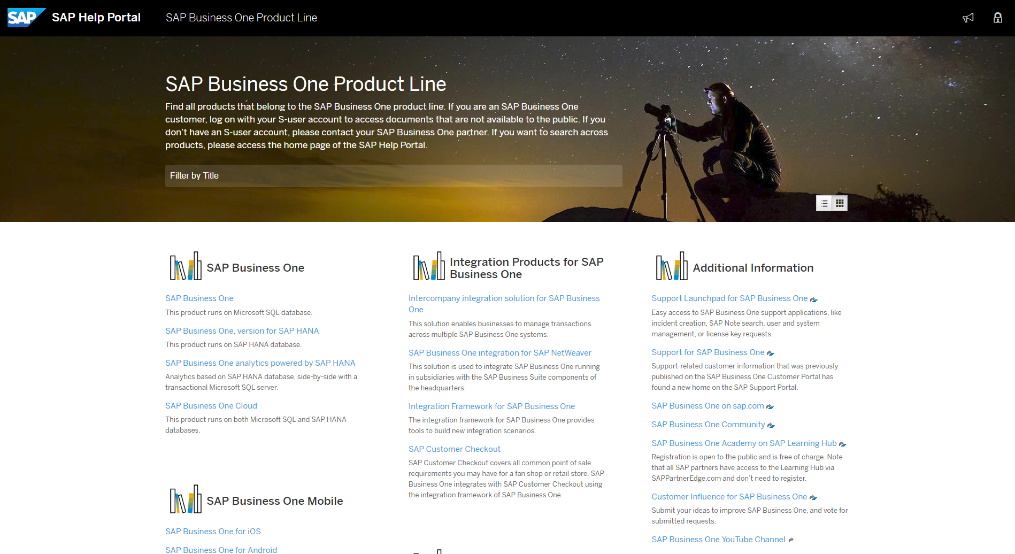
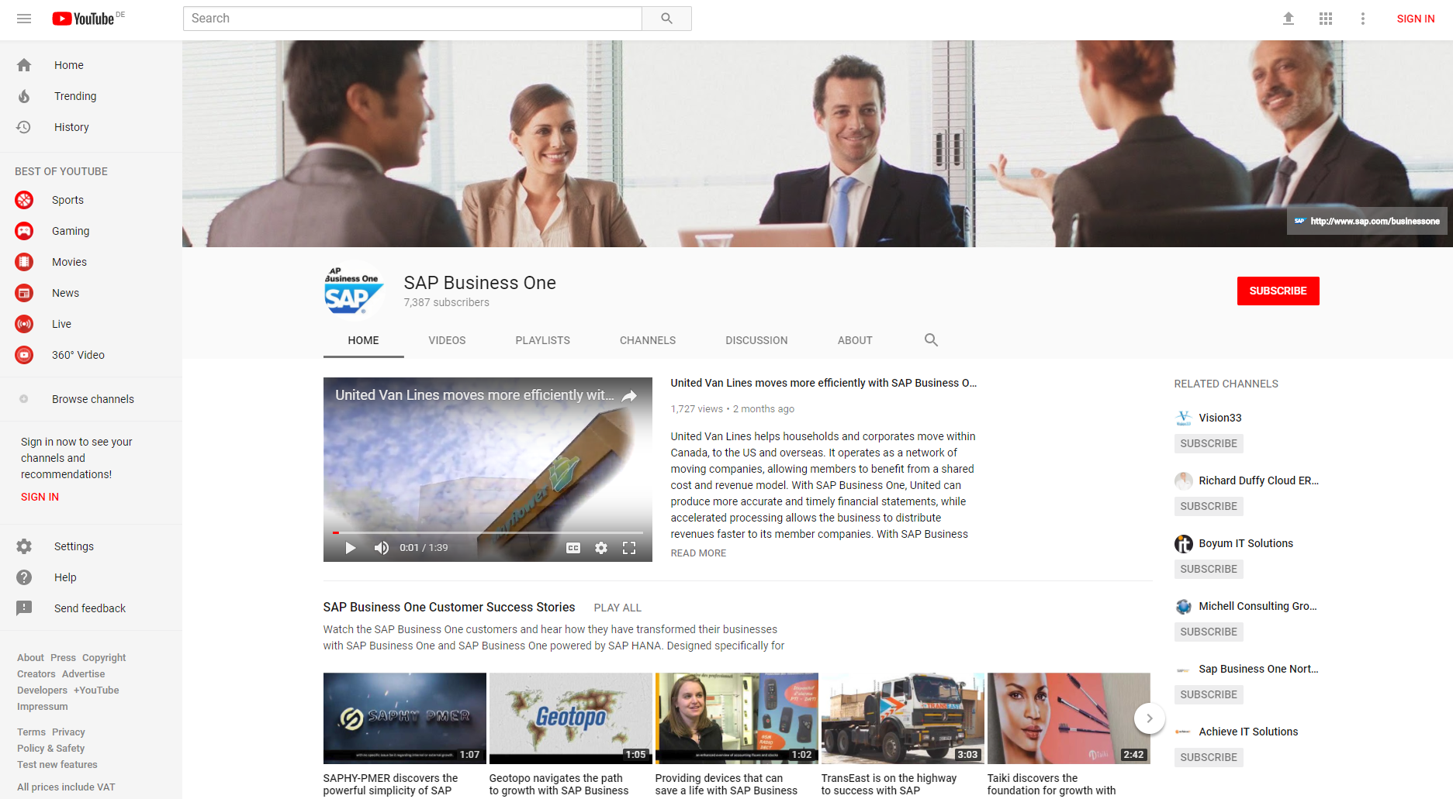

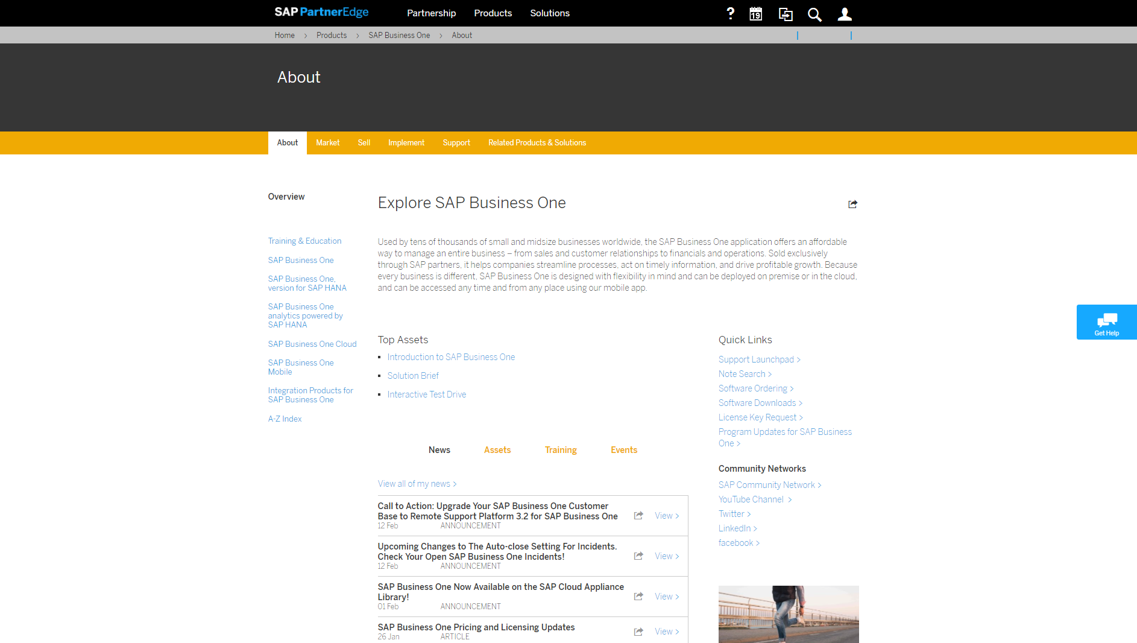

Information for Customers, Prospects, and Partners on SAP Business One
Public SAP.com Website
SAP Help Portal
Global YouTube Channel
SAP Business One Learning Hub
SAPPartnerEdge Portal
(Partner only)
Product Road Map
(Customer and Partner only)

Slide 28
Thank you.
Contact information:
  F name L name
  Title
  Address
  Phone number

